Slide 1
Slide 1: Title Slide
Title: Healthcare Trend Analysis & Visualization
Subtitle: Using Python and Power BI for Data-Driven Insights
Presented by: Subham Biswas

Slide 2
Slide 2: Project Objective Analyze and understand trends in healthcare data. Identify patterns in patient demographics, admissions, medical conditions, and billing. Use Python for data processing and machine learning. Use Power BI for interactive data visualization.

Slide 3
Slide 3: Data Sources
Scraped articles from: Medical News Today
Hospital dataset with the following columns:
Name, Age, Gender, Blood Type, Medical Condition
Date of Admission, Doctor, Hospital, Insurance Provider
Biling Amount, Room Number, Admission Type, Discharge Date
Medication, Test Results

Slide 4
Slide 4: Web Scraping & Preprocessing (Python)
Used BeautifulSoup to extract news article titles and links.
Cleaned and stored article data in CSV format.
Preprocessed hospital data for missing values and data types.

Slide 5
Slide 5: Exploratory Data Analysis (EDA)
Explored:
Gender and age-wise distribution
Common medical conditions
Billing amount variation by insurance providers
Medication vs. test result correlation

Slide 6
Slide 6: Predictive Modeling
Built a linear regression model to predict length of stay.
Features used: Age, Billing Amount
Target: Days between Admission and Discharge
Evaluated using Mean Absolute Error (MAE)

Slide 7
Slide 7: Power BI Visualization
Created the following dashboards:
Admission Trends: Yearly patient admissions
Insurance Distribution: Pie chart of provider shares
Medication Effectiveness: Box plot of Test Results
Conditions by Gender & Blood Type: Bar chart

Slide 8
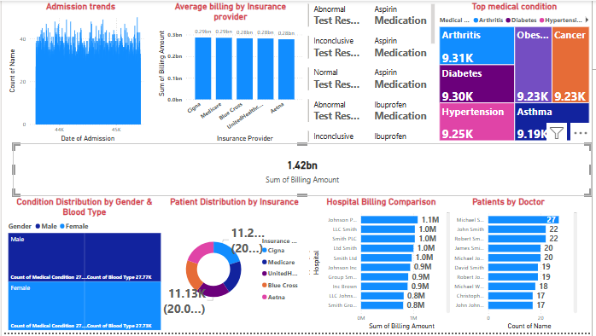

Slide 9
Slide 8: Key Insights
Elderly patients face more chronic conditions.
Certain medications show higher average effectiveness.
Major differences exist in average billing by insurer.
Gender and blood type have some correlation with conditions.

Slide 10
Slide 9: Conclusion
Python helped automate scraping and modeling.
Power BI enabled impactful storytelling with visuals.
The approach is scalable to broader healthcare analysis.

